Slide 1
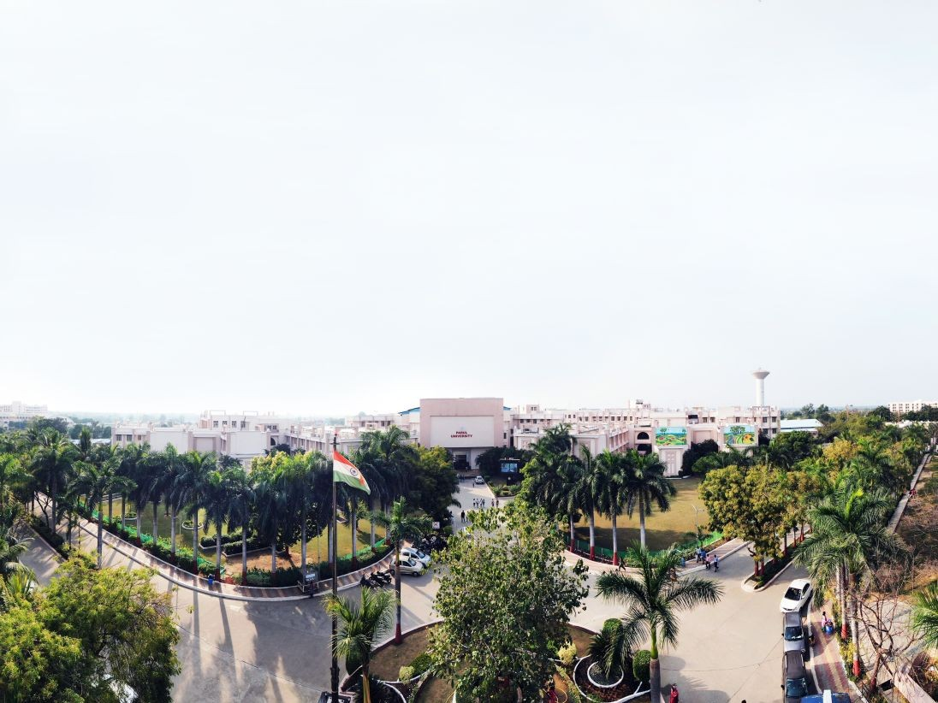


Software Engineering (303105254)

Slide 2
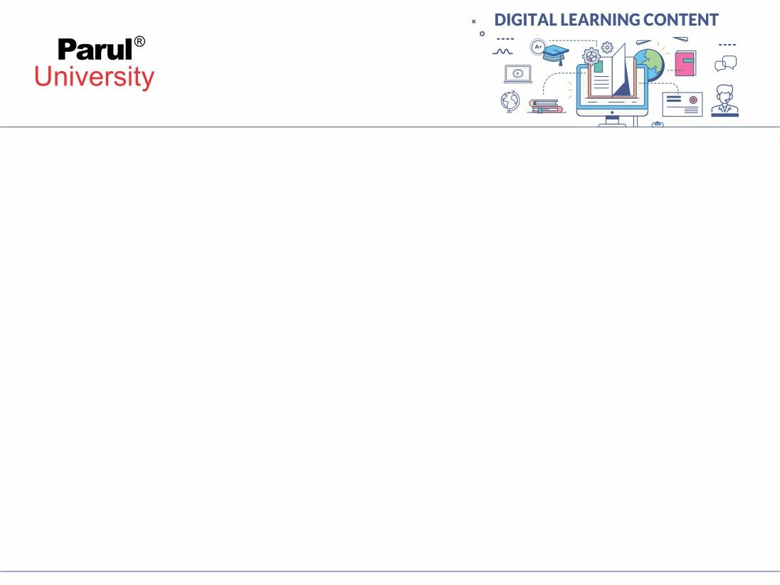

UNIT-7
CASE Tools and Advance Practices of System Dependability and Security

Slide 3
CASE Tools
To make the software system building faster , a new concept of designing software was introduced, known as Computer Aided Software Engineering (CASE)..
It deals with development and maintenance of software projects by using various software tools.
CASE includes software systems that are intended to provide Automated Support for software process activities. Automated Support is something that we use some software to develop another software
Image source : Google

Slide 4

Why CASE Tools?
CASE makes use of computer-assisted method to organize and control the development of software, especially on large, complex projects that involve many software components and people.
Use of CASE allows designers, code writers, testers, planners and managers to share a common understanding of project progress at each stage of development.
CASE tools are mainly used to decrease the development time & cost and improve software quality

Slide 5
CASE tools are developed for the following purposes:
Quick Installation
Reduce Coding & Testing time.
Improve graphical techniques and data flow.
Enhanced analysis and design development.
Easily work with documentation
Increase rate of system development .

Slide 6
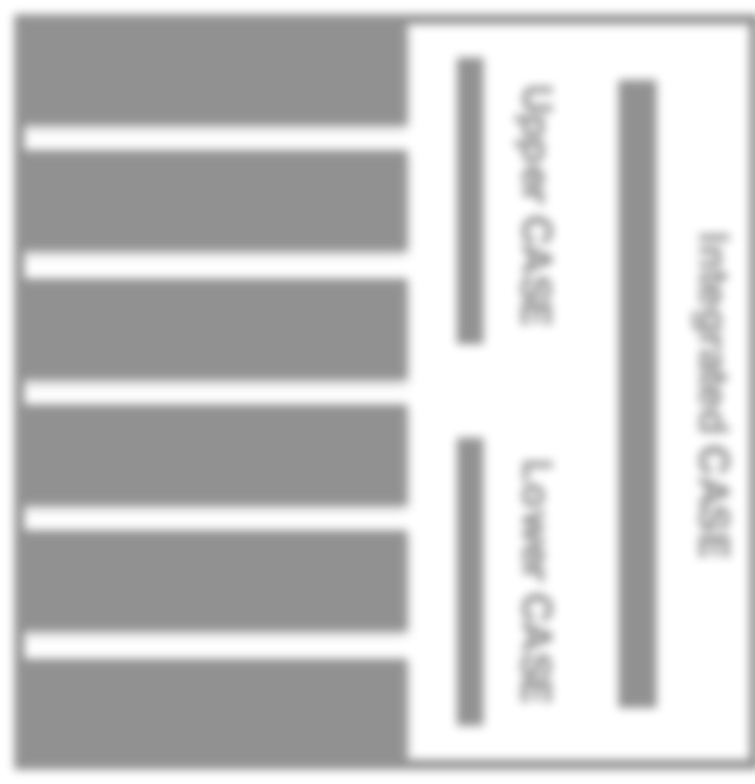
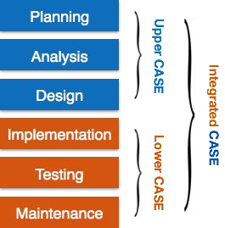
Components of CASE Tools
There are two types of CASE tools:
Classic CASE tools: Interactive debuggers, compilers, project progress control systems
Real Case tools: support several phases of development
Upper CASE tools support analysis and design.
Lower CASE tools refer to the location in these phases in the Waterfall Model.
III.
Integrated CASE tools support analysis, design,
and coding.
Image source : Google

Slide 7
Types of CASE Tools
Diagram tool :These tools represent system components, data and control flow in a large set of software components and system structure in a graphical manner.
Process Modelling Tools : Process modelling is used to create software process model, which is used to develop the software.
Project Management Tools : These tools will be used for project planning, cost and effort estimation, project scheduling and resource planning.
Documentation Tools : Documentation in a software project starts prior to the software process, goes throughout all phases of SDLC and after the completion of the project.

Slide 8
Types Of CASE Tools:
Analysis Tools
Design Tools
Configuration Management Tools
Change Control Tools
Programming Tools
Prototyping Tools
Web Development Tools
Quality Assurance Tools
Maintenance Tools

Slide 9
Advantages
Improve quality and productivity of software
Produces software that meets user demands & requirements
Produce system with good documentation
Effective for large & complex systems
Reduce error correction & maintenance time
More Flexible systems

Slide 10
Disadvantages
CASE tools are complex to use
Not easy to maintain
Good quality CASE tools are very expensive
Require training of maintenance staff
It might become difficult to integrate with existing systems

Slide 11

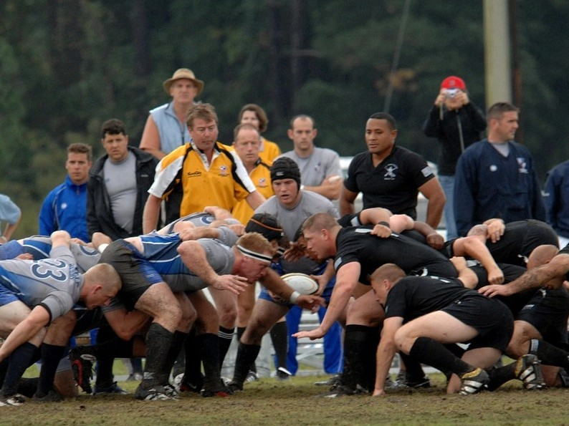
What Is Scrum?
A scrum is a method of restarting play in rugby that involves players packing closely together with their heads down and attempting to gain possession of the ball

Slide 12
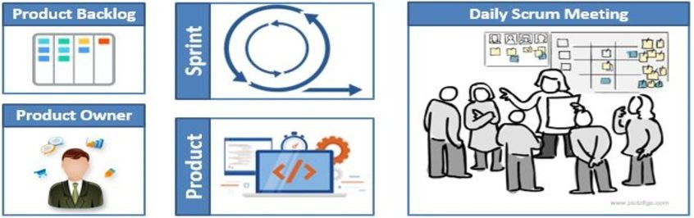
SCRUM Developments
Scrum is a strategy for product development that organizes software developers as a team to achieve a common goal i.e. to create a product that is ready for market. It is a subset of agile, that is widely used.
It is an agile process model which is used for developing the complex software systems.
It is a lightweight process framework. (Lightweight refers to minimizing process overhead to maximize the productivity.)

Slide 13


Roles in Scrum Team
Product Owner
Voice & inputs of Customer Voice of the Business
He takes the scenarios that have the most business value

Slide 14
What Does He / She Do?
Vision for product
Represent the interests of the business
Represents the customers
Owns the product backlog
Creates acceptance criteria for the backlog items
Prioritizes tasks

Slide 15

Scrum Master
“Servant leader”

Slide 16
What Does He/She Do ?
Removes obstacles to the ability of team to deliver sprint goals
Ensures that scrum process is executed as per plans
Facilitates changes
He/She is not the team boss. They prioritize a high-performing, self-organized team.

Slide 17

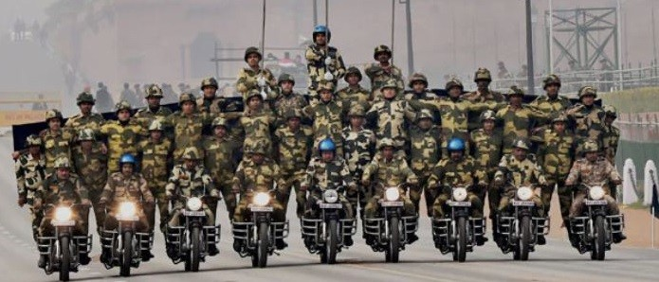
Development Team
One for one and one for all

Slide 18

What Does He/She Do ?
Complete user stories to incrementally increase the value of the product
Self-organizes to get all of the necessary work done
Creates the estimates
Make the “how to accomplish goal” decisions
Avoid “not my job” thinking

Slide 19

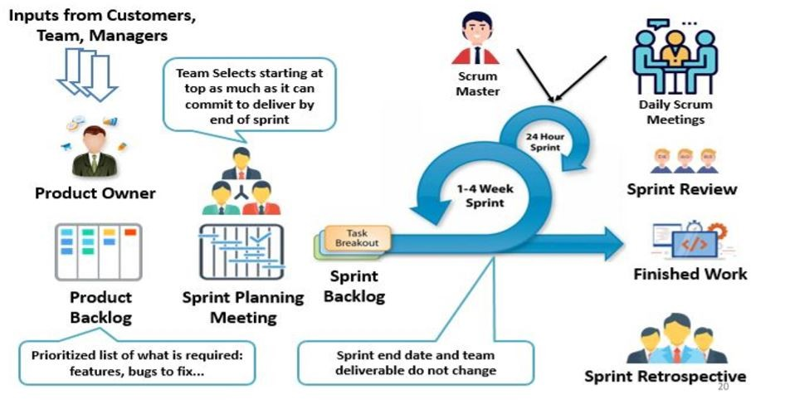
Scrum Framework At A Glance

Slide 20
Sprint
fixed length, normally 2–4 weeks
The starting point for sprint planning is the product backlog
During the assessment phase of the sprint, this is reviewed after which the priorities and risks are assigned
selection phase involves all of the project team who work with the customer to finalize the features and functionality to be developed during the sprint.
Short daily meetings
Scrum master protects the development team from external distractions

Slide 21
Stand-up Meetings
share information
describe their progress
problems that have arisen
what is planned for the following day.
everyone on the team is well informed of what is going on
short-term planning

Slide 22

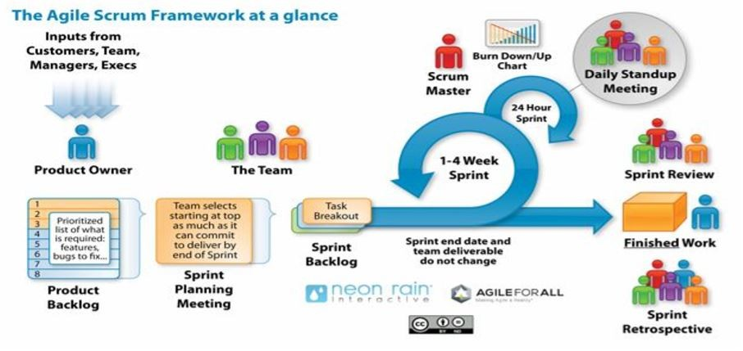
Continued..

Slide 23
Dependable Systems
A dependable system is one that can be trusted by users. It requires the system to be highly available (to authorized users) and at the same time ensure a high degree of service integrity.
A system is dependable when it can produce the results for which it was designed, and creates no adverse effects.

Slide 24
System Dependability
For many computer-based systems, the most important system property is the dependability of the system.
The dependability of a system reflects the extent of user’s trust in that system. It reflects how much user trusts that the system will operate as users expect and that it will not ‘fail’ in normal use.
Dependability covers the related systems properties of reliability, availability and security. These are all inter dependent.

Slide 25
Importance of dependability
System failures may have huge effects with huge number of users affected by the failure.
Systems that are not dependable and are unreliable, unsafe or insecure are prone to user rejection.
The system failure may be very costly if the failure leads to monetory or physical loss.
Undependable systems may lead to loss of information causing a high consequent recovery cost.

Slide 26
Causes of failure
Hardware failure
Hardware fails because of errors in design and manufacturing or due to components wear out.
Software failure
Software can fail because of specification, implementation or design errors.
Operational failure
Human operators make mistakes. Now perhaps the largest single cause of system failures in socio-technical systems.

Slide 27

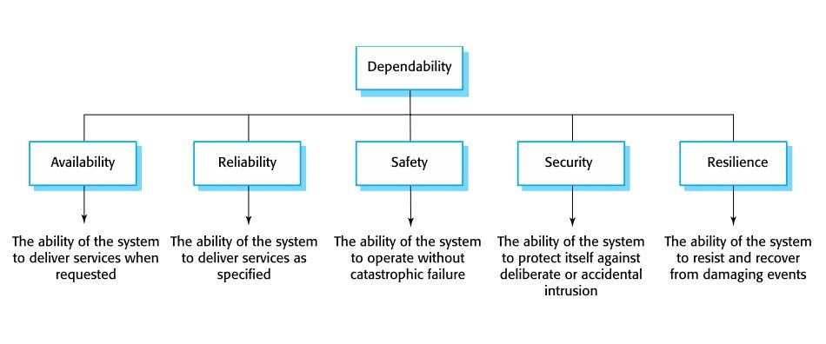
The principal dependability properties

Slide 28
Reliability Engineering
In general, software customers expect all software to be dependable. However, for non-critical applications, they may be willing to accept some system failures.
Some applications (critical systems) have very high reliability requirements and special software engineering techniques may be used to achieve this.
Medical systems
Telecommunications and power systems
Aerospace systems

Slide 29
Reliability can be defined formally only with respect to specification of system i.e. a failure is a deviation of results or operations from a specification.
But, large number of specifications are incomplete or incorrect – so, a system that adheres to its specification may still ‘fail’ from the users point of view.
Additionally, users don’t read specifications, hence are unaware about ideal system behaviour.
Therefore perceived reliability is more important in practice.
The formal definition of reliability does not always reflect the user’s perception of a system’s reliability The assumptions that are made about the environment where a system will be used may be incorrect
Usage of a system in an office environment is likely to be quite different from usage of the same system in a university environment

Slide 30
The consequences of system failures affects the perception of reliability
Unreliable windscreen wipers in a car may be irrelevant in a dry climate
Failures that have serious consequences (like an engine failure in a car) are given greater weight by users than failures that are inconvenient

Slide 31
Fault, Errors & Failures
Term | Description
Human error or mistake | Human behaviour that results in the introduction of faults into a system. For example, in the wilderness weather system, a programmer might decide that the way to compute the time for the next transmission is to add 1 hour to the current time. This works except when the transmission time is between 23.00 and midnight (midnight is 00.00 in the 24-hour clock).
System fault | A characteristic of a software system that can lead to a system error. The fault is the inclusion of the code to add 1 hour to the time of the last transmission, without a check if the time is greater than or equal to 23.00.
System error | An erroneous system state that can lead to system behavior that is unexpected by system users. The value of transmission time is set incorrectly (to 24.XX rather than 00.XX) when the faulty code is executed.
System failure | An event that occurs at some point in time when the system does not deliver a service as expected by its users. No weather data is transmitted because the time is invalid.

Slide 32
Reliability achievement
Fault avoidance
Development technique are used that will either nullify the probability of mistakes or catch them before they lead to system faults.
Fault detection and removal
Verification and validation techniques are used that will improve the chances of detecting and correcting errors before the system goes into service.
Fault tolerance
Run-time techniques are so that system faults do not lead to system errors and/or that system errors don’t cause system failure.

Slide 33
Safety Engineering
Safety is a characterstic of a system that reflects the system’s ability to operate, normally or abnormally, without danger of causing human injury or death and without damage to the system’s environment.
It is important to consider software safety as most devices whose failure is critical now incorporate software-based control systems.

Slide 34
Software in safety-critical systems
Some systems may be software-controlled so the decisions taken by the software and subsequent actions are safety-critical.
Therefore, the software behaviour is directly related to the overall safety of the system.
Software is extensively used for checking and monitoring other safety-critical components in a system.
– Eg.,all aircraft engine components are monitored by software looking for early indications of component failure. This software is safety-critical because, if it fails, other components may fail and cause an accident.

Slide 35
Safety and reliability
Safety and reliability are distinct yet related
In general, reliability and availability are necessary but not sufficient to ensure system safety.
Reliability is concerned with conformance to a given specification and delivery of service
Safety is concerned with ensuring system cannot cause damage irrespective of whether or not it conforms to its specification.
System reliability is essential for safety but is not enough
Reliable systems can be unsafe

Slide 36
Unsafe reliable systems
There might be hidden faults in a system that are not detected for long time and rarely cause trouble.
Specification errors
If specification of a system is wrong, system might still behave in specified manner but lead to an an.
Hardware failures generating spurious inputs
Hard to anticipate in the specification.
Context-sensitive commands i.e. issuing the right command at the wrong time
Often the result of operator error.

Slide 37
Safety criticality
Primary safety-critical systems
The failure of Embedded software can cause the related hardware to fail and directly affect people. Example is the insulin pump control system.
Secondary safety-critical systems
Systems whose failure results in faults in other (socio-technical) systems, which can then have safety consequences.
For example, a hospital system is safety-critical as failure may lead to inappropriate treatment being prescribed.
Infrastructure control systems are also secondary safety-critical systems.

Slide 38
Hazards
Events or circumstances that can cause an accident
Faulty valve in reactor control system
Wrong computation by software in navigation system
Failure to detect possible allergy in medication prescribing system
Hazards do not inevitably result in accidents
accident prevention actions can be taken.

Slide 39
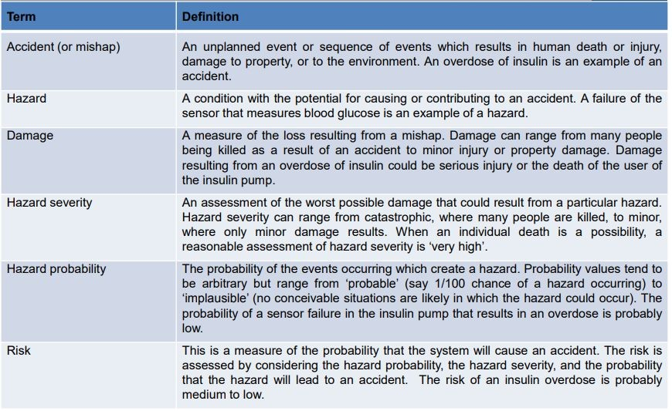
Safety terminology

Slide 40
Safety Specification
The aim of safety engineering is to find protection requirements that can assure that system failures do not cause damage to any human or environment.
Safety requirements can very well be ‘shall not’ requirements i.e. they explain situations and events which must never occur.
Functional safety requirements define:
Checking and recovery features which should be part of a system
Features that provide security from external attacks &system failures

Slide 41
Safety achievement
Hazard avoidance
The system is built in such a way that some classes of hazard simply cannot arise.
Hazard detection and removal
The system is designed so that hazards are detected and removed before they result in an accident.
Damage limitation
The system includes protection features that minimise the damage that may result from an accident.

Slide 42
Security Engineering
Security Engineering is the use of methods, techniques and tools that support the maintenance and development of systems that can withstand malicious attacks that are aimed at damaging a computer-based system and/or data in system.
It is a sub-field of computer security.

Slide 43
Security dimensions
Confidentiality
Information in the system is disclosed only to the intended audience.
Integrity
The system should ensure that there is no corruption or malicious modification in data.
Availability
Access to a system or its data that is normally available may not be possible.

Slide 44
Security levels
Infrastructure security
Application security
Operational security

Slide 45

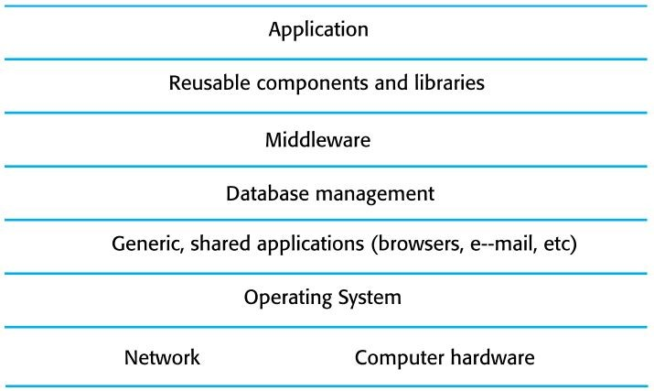
System layers where security may be compromised

Slide 46

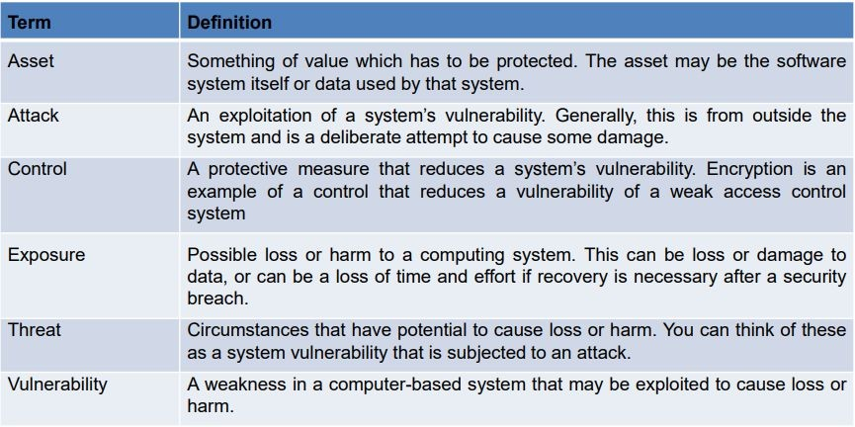
Security terminology

Slide 47
Threat Types
Interception threats that allow an attacker to gain access to an asset.
A possible threat to the Mentcare system might be a situation where an attacker gains access to the records of an individual patient.
Interruption threats that allow an attacker to make part of the system unavailable.
A possible threat might be a denial of service attack on a system database server so that database connections become impossible.

Slide 48
Continued..
Modification threats that allow an attacker to tamper with a system asset.
In the hospital management system, a modification threat would be where an attacker alters or destroys a patient record.
Fabrication threats that allow an attacker to insert false information into a system.
In a bank system, false transactions might be added to the system that transfer money to the perpetrator’s bank account.

Slide 49
Security and dependability
Security and reliability
If a system is attacked and the system or its data are corrupted as a consequence of that attack, then this may induce system failures that compromise the reliability of the system.
Security and availability
A common attack on a web-based system is a denial of service attack, where a web server is flooded with service requests from a range of different sources. The aim of this attack is to make the system unavailable.

Slide 50
Continued…
Security and safety
An attack that corrupts the system or its data means that assumptions about safety may not hold. Safety checks rely on analysing the source code of safety critical software and assume the executing code is a completely accurate translation of that source code. If this is not the case,
safety-related failures may be induced and the safety case made for the software is invalid.
Security and resilience
Resilience is a system characteristic that reflects its ability to resist and recover from damaging events. The most probable damaging event on networked software systems is a cyberattack of some kind, so most of the work now done in resilience is aimed at preventing cyber attacks

Slide 51
Resilience Engineeirng
The resilience of a system is a judgment of how well that system can maintain the continuity of its critical services in the presence of disruptive events, such as equipment failure and cyberattacks.
Cyberattacks by malicious outsiders are perhaps the most serious threat faced by networked systems but resilience is also intended to cope with system failures and other disruptive events.

Slide 52
Essential resilience ideas
The idea that some of the services offered by a system are critical services whose failure could have serious human, social or economic effects.
The idea that some events are disruptive and can affect the ability of a system to deliver its critical services.
The idea that resilience is a judgment – there are no resilience metrics and resilience cannot be measured. The resilience of a system can only be assessed by experts, who can examine the system and its operational processes.

Slide 53
Resilience engineering assumptions
Recognition : The system or its operators should recognise early indications of system failure.
Resistance : If the symptoms of a problem or cyberattack are detected early, then resistance strategies may be used to reduce the probability that the system will fail.
Recovery : If a failure occurs, the recovery activity ensures that critical system services are restored quickly so that system users are not badly affected by failure.
Reinstatement : In this final activity, all of the system services are restored and normal system operation can continue.

Slide 54
Resistance
Resistance strategies may focus on isolating critical parts of the system so that they are unaffected by problems elsewhere.
Resistance includes proactive resistance where defences are included in a system to trap problems and reactive resistance where actions are taken when a problem is discovered.

Slide 55

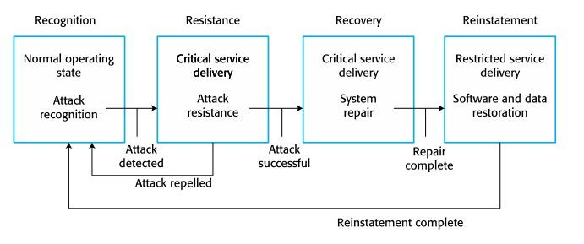
Resilience activities

Slide 56
References
Pressman, Roger S. Software engineering: a practitioner's approach. Palgrave Macmillan, 2005.
Sommerville, Ian. Software Engineering: Pearson New International Edition. Pearson Education Limited, 2013.
Jalote, Pankaj. An integrated approach to software engineering. Springer Science & Business Media, 2012.
www.google.com
www.wikipedia.com
www.pixabay.com

Slide 57
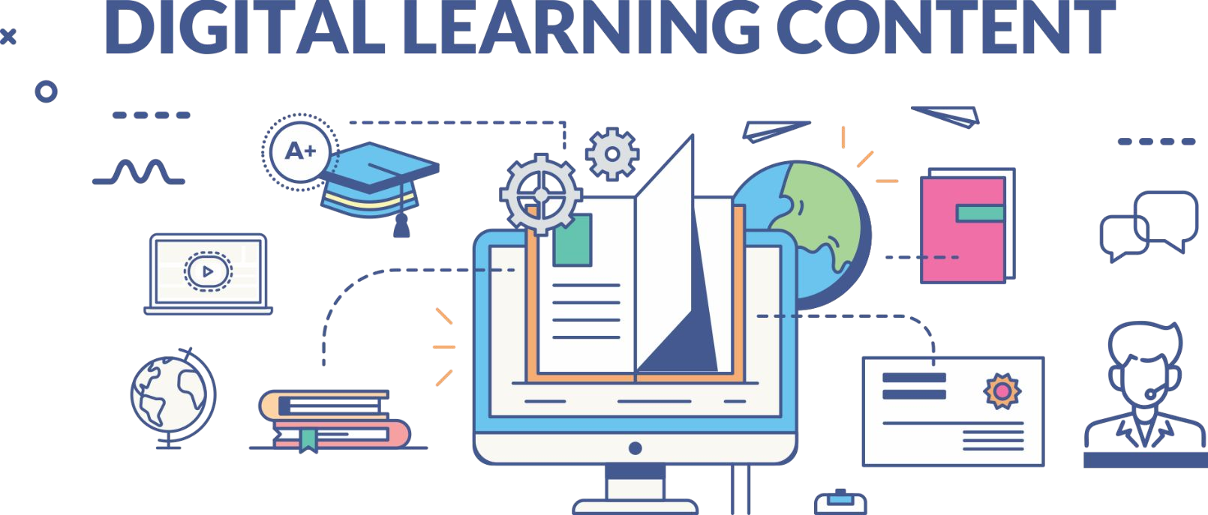

www.paruluniversity.ac.in

